Slide 1
Digital Logic Design and Application
Lecture #08
Standard combinational components:
Parity check, Comparator, Adder, ALU

Slide 2
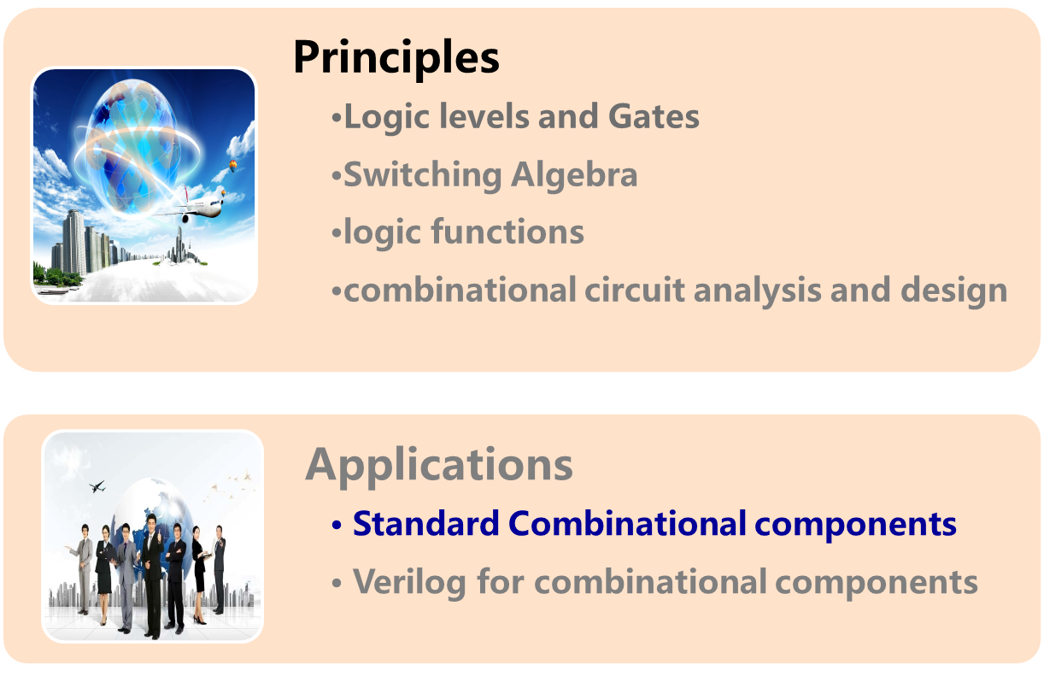
Topic 2-1 combinational circuits design

Slide 3

* 1. Parity Generation and Checking
Q：
How do we detect the error in data transmitting and storage process?
ASCII code for 0 (0110000)
→Even（偶）
ASCII code for 1
(0110001)
→Odd（奇）
——Parity Check（奇偶校验）
Notes:
我们知道不管多么复杂的信息，在数字系统中都用一串01信号来表示；其次无论在传输的那个环节出错，最终表现出来的结果也就是0变成1，或者1变成0，即数字bit发生了翻转。
要识别这个错误，接收端一定要有关于发送数据的其他信息，通过检测这个额外的信息的变化就可以发现是否出错。对数字信号来说出错前后的信号的区别无非是数据当中的0和1的数量与排列发生了变化。比如出错前的编码是5个0，2个1；出错以后的编码有4个0、3个1。相应的排列也发生了变化。二者相比，显然数1的个数在数字电路里更容易实现。因此我们可以试着通过检查数据当中的0或者是1的个数的变化来发现数据传输过程当中的错误。
反映数据中1或者0的个数的最简单的指标就是数字信号的奇偶性（parity）。正确的0的ascii码的奇偶性就偶的，因为它有偶数个1；而1的ascii码的奇偶性就奇的，因为它有奇数个1。
如果一个数字信号的奇偶特性在传输或者存储的过程当中发生了改变，一定是有错误发生。因此我们可以通过检测数字信号的奇偶性的变化来发现错误，这种方法叫做奇偶校验。

Slide 4
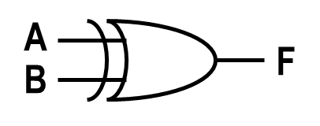
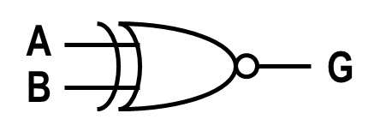
* 1. Parity Generation and Checking
Detect errors in the transmission and storage process.
Odd-Parity Check（奇校验/检查）Circuit
  Output is 1 if an odd number of its inputs are 1.
Even-Parity Check（偶校验/检查）Circuit
  Output is 1 if an even number of its inputs are 1.
2-bit parity checking circuits
  XOR
  XNOR
Notes:
通过真值表设计法，可以得到2-bit的奇偶校验电路——两输入异或门XOR，同或门XNOR。

Slide 5
XOR gates and Parity Circuits
XOR and XNOR gates: 2-input, 1-output
  XOR F= A ⊕ B =A·B’+A’·B
  XNOR G= A⊙B =A·B+A’·B’
Logic operation priority
NOT>AND>XOR, XNOR>OR
Operation with logic constants and the input itself
  A⊕A=0 A⊕A’=1 A⊕0=A A⊕1=A’
A⊙A=1 A⊙A’=0 A⊙1=A A⊙0=A’

Slide 6
Operation with complements of inputs and outputs
Any two signals (inputs or output) of an XOR or XNOR gate may be complemented without changing the output value.
Any signal (inputs or output) of an XOR or XNOR gate is complemented the logic function is complemented.
A
B
F
A
B
F
A
B
F
A
B
F
F=A⊕B
F=A’⊕B’
F=(A’⊕B)’
F=(A⊕B’)’
A⊕B=(A⊙B)’
A⊕B’=A⊙B

Slide 7
Exam the parity for n-bit data
  A⊕A=0 A⊕A’=1 A⊕0=A A⊕1=A’
A⊙A=1 A⊙A’=0 A⊙1=A A⊙0=A’
1 odd number of 1
D₁ ⊕ D₂ ⊕ … ⊕ D_{n} =
0 even number of 1
1 Even number of 0
0 odd number of 0
A₁⊙A₂⊙ … ⊙A_{n} =
Notes:
不完全归纳法可证明。

Slide 8
Exam the parity for n-bit data
D1
D2
D3
D4
DN
Daisy-Chain Connection
ODD
n-1 XOR, n-input, 1-output
D1
D2
Tree Structure
D3
D4
ODD
DM
DN
faster

Slide 9
Parity checking application for n-bit data
Generate the check-bit（校验位）first then pad the check-bit after the data and we get the parity checking code(校验码).
The error checking is done by comparing the parity of the checking codes at both of the transmitter and the receiver.
Checking code=information code +Check bit
（校验码=信息字段 +校验位）
0
The ODD parity check-bit for data 1001 0001 is .
The checking code is .
1001 0010 0
1
The Even parity check-bit for data 1001 0001 is .
The checking code is .
1001 0001 1
Notes:
校验码需要通过奇偶校验（或称为奇偶检查更合适）电路来产生，通过比较收发双端校验码的奇偶性是否发生变化来检查是否有错误发生。

Slide 10
Parity checking application for n-bit data
Use parity check circuit to test the parity of data inputs.
Generate check-bit according to a certain parity check rule.
  ODD parity check: gurantee odd 1s
  Even parity check: gurantee even 1s
Send the check-bit along with data and check the parity of the whole check code to find whether there is an error occurs.

Slide 11
8-bit parity checking using MSI 74x280
DB[0:7]
DB[0:7]
TX
RX
74x280
9-bit
Checking code
74x280
A
A
EVEN
（偶）
─Check bit
─ Error
EVEN
ODD
（奇）
ODD
ERROR
H
I
Check bit
H
I
Check bit
Guarantee even number of 1
Fault when ODD is asserted
ODD
EVEN

Slide 12
2. Comparators
Chap. 4.9
Comparator: compare two binary words and indicate whether they are equal ( =, ≠) or not.
Magnitude comparator: indicate an arithmetic relationship between the words ( >, =, < )
1-bit comparators
  —— use XOR ( XNOR )
A
B
A
B
DIFF
EQ
DIFF : different
EQ : equal
Notes:
使用真值表可以得到1-bit真值表的电路——2输入XOR，XNOR

Slide 13
Comparator Structure
  How to build n-bit comparators?
  All of input-bit pairs are equal.
  Any of input-bit pairs are different.
A0
B0
series comparator
parallel comparator
A1
B1
DIFF
A2
B2
We can build an n-bit comparator using n 2-input XOR gates and one n-inputs OR gate.
A3
B3
Notes:
或者使用n个2输入XNOR门和一个n输入与门，得到equal输出。

Slide 14
Comparator Structure
series comparator
parallel comparator
Cascading input
（级联输入）
A
B
EQ
EQO
EQI
X₀
Y₀
X₁
Y₁
X_{N-1}
Y_{N-1}
X Y
CMP
EQI EQO
X Y
CMP
EQI EQO
X Y
CMP
EQI EQO
EQ₁
EQ₂
EQ_{N-1}
EQ_{N}
1
Larger proceeding time for serial comparators
Notes:
在1-bit比较器的基础上，添加级联输入，可以级联扩展得到n-bit的比较电路。

Slide 15
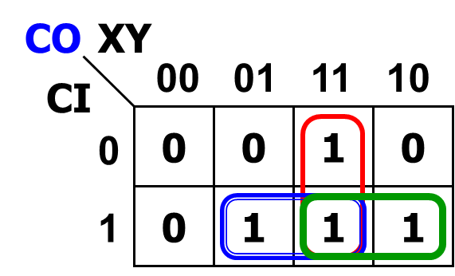
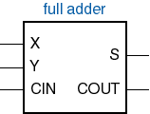

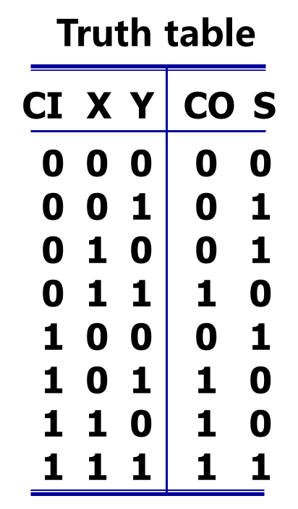
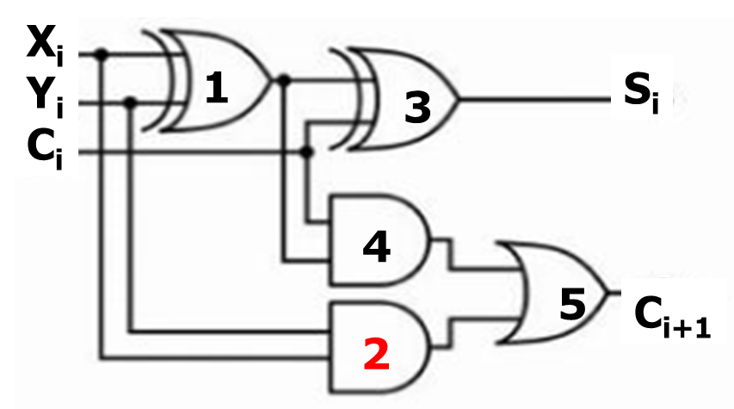

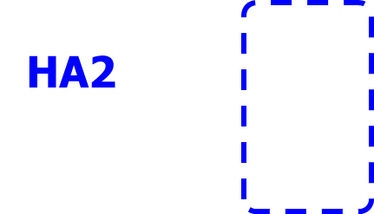


3. Adder
Chap. 4.3
S = X ⊕ Y ⊕ CI
1-bit Full adder
HA1
HA2
ts
X
+ Y
tc1 ts
+ CI
tc2 S
+ tc1
Co S
tc2
tc1
2 half adders + OR gate → a full adder

Slide 16
Ripple Adder
X0 Y0
X1 Y1
X2 Y2
X3 Y3
X Y
CI CO
S
X Y
CI CO
S
X Y
CI CO
S
X Y
CI CO
S
C1
C2
C3
C0
C4
=0
S0
S1
S2
S3
Speed limited by carry chain
Faster adders eliminate or limit carry chain
—— parallel adder, carry lookahead,

Slide 17
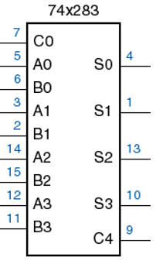
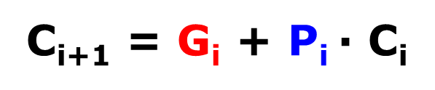
Carry lookahead
S = X ⊕ Y ⊕ CI
G_{i}: carry generate
P_{i}=(X+Y)·CI
P_{i}: carry propagate
carry lookahead（超前进位）: use the G_{i} to generate a carryout without carry in from lower bits. Speed propagation delay of the carry chain.
Notes:
进位的传递是加法器中信号延迟的主要来源，而Gi与进位输入无关，无须等待进位传递，直接由两个输入X和Y可产生进位输出。

Slide 18
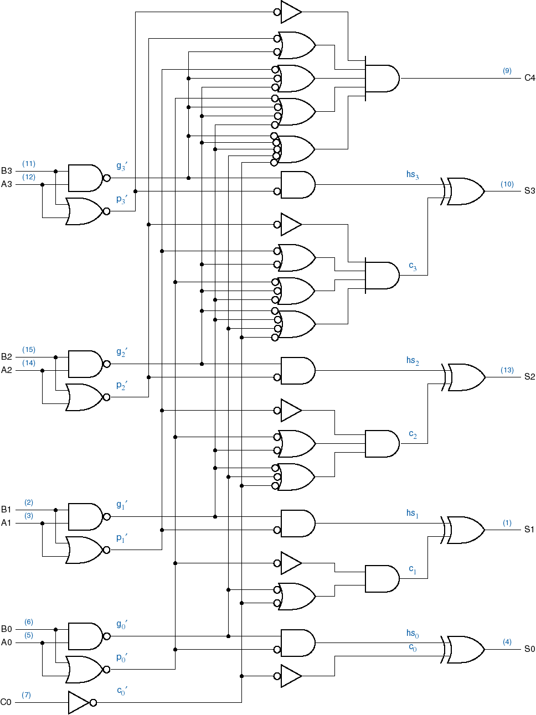
74x283
4-bit adder
Uses carry lookahead internally
c3
generate
carry-out
1-bit Carry-lookahead Adder
sum
propagate
carry-in from
previous stage

Slide 19
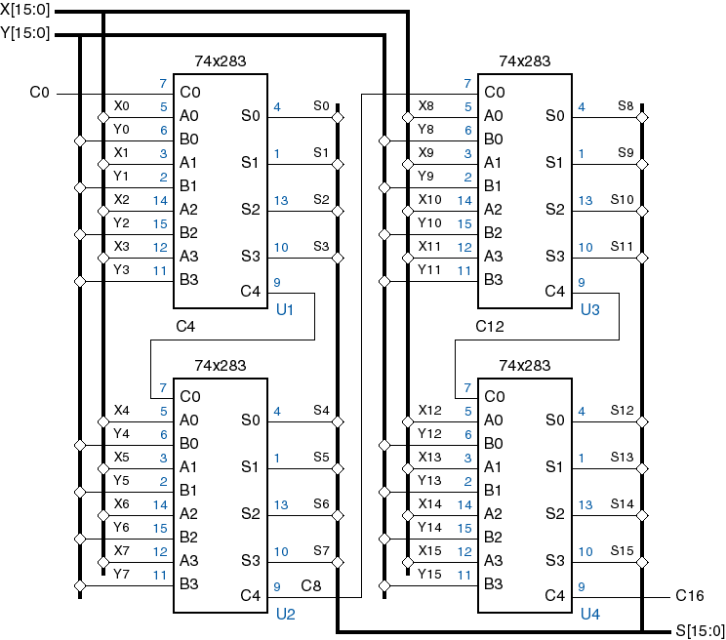
Use ‘283 to Build a 16-bit adder
4-bit adder with Carry lookahead
0
Ripple carry between groups, Carry lookahead within chips
_{C16}

Slide 20
Chap. 4.5
4. Adder-Subtractor combination
&Chap2.2
Using 2’s complement（二进制补码） to do the add/subtraction with full adder.
  Addition → X+Y
  Subtraction → X-Y=X+(-Y) 2’s
4-bit (-3)_{2’s}：1101
(3)_{2’s}： 0011
Exg. 3-3=?
+
(0)_{2’s}：10000

Slide 21
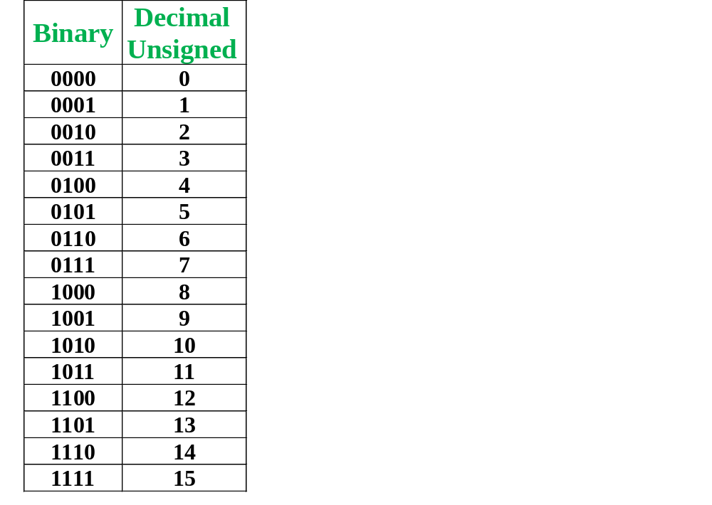
Representations of negative numbers
Positive
Positive & Negative

Slide 22
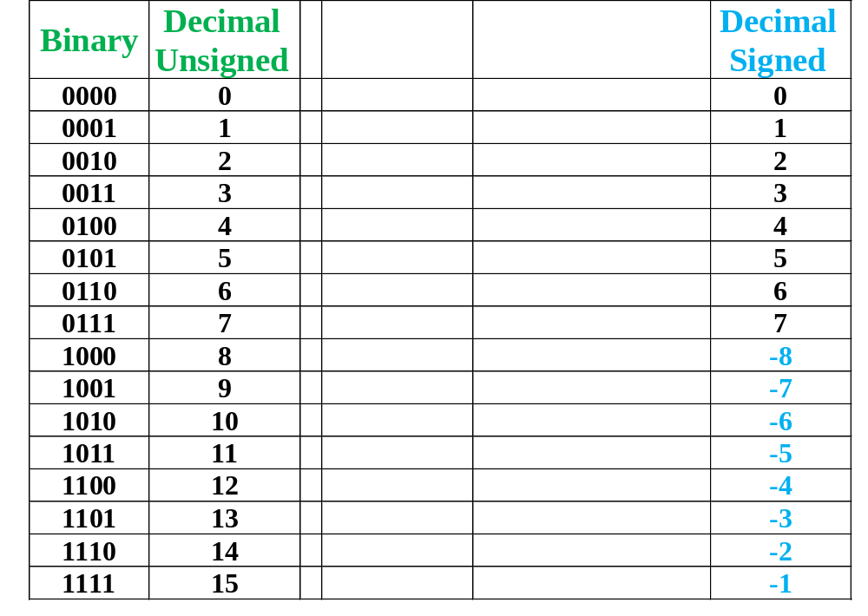
Positive
Positive & Negative

Slide 23
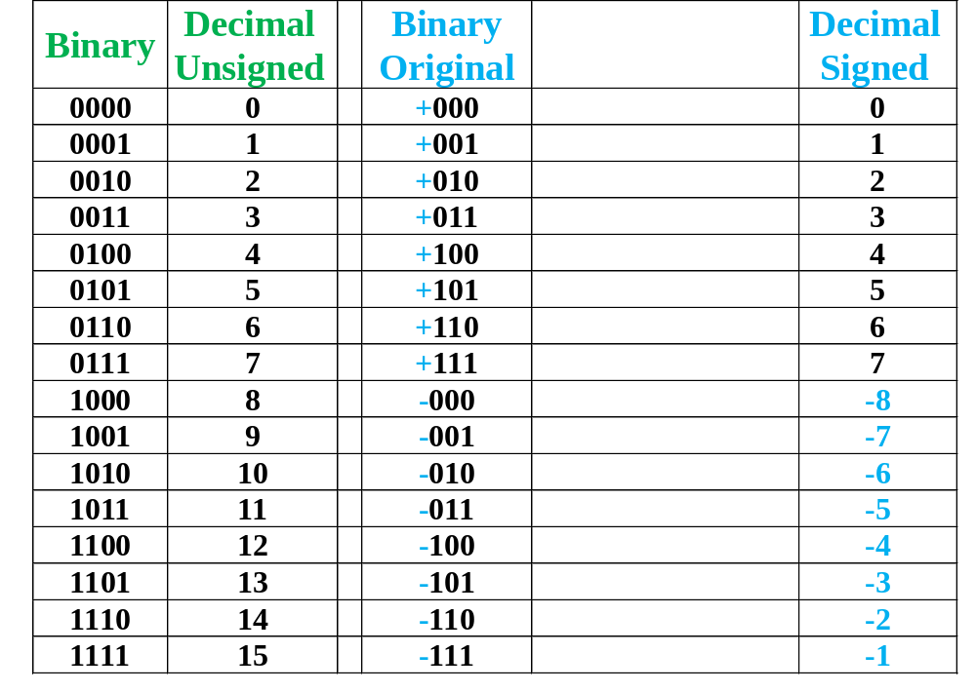
Positive
Sign-magnitude
Positive & Negative
0000
0001
0010
0011
0100
0101
0110
0111
—
1111
1110
1101
1100
1011
1010
1001
0 for positive
1 for negative
Sign-magnitude code(符号数值码) can’t be used to calculate.

Slide 24
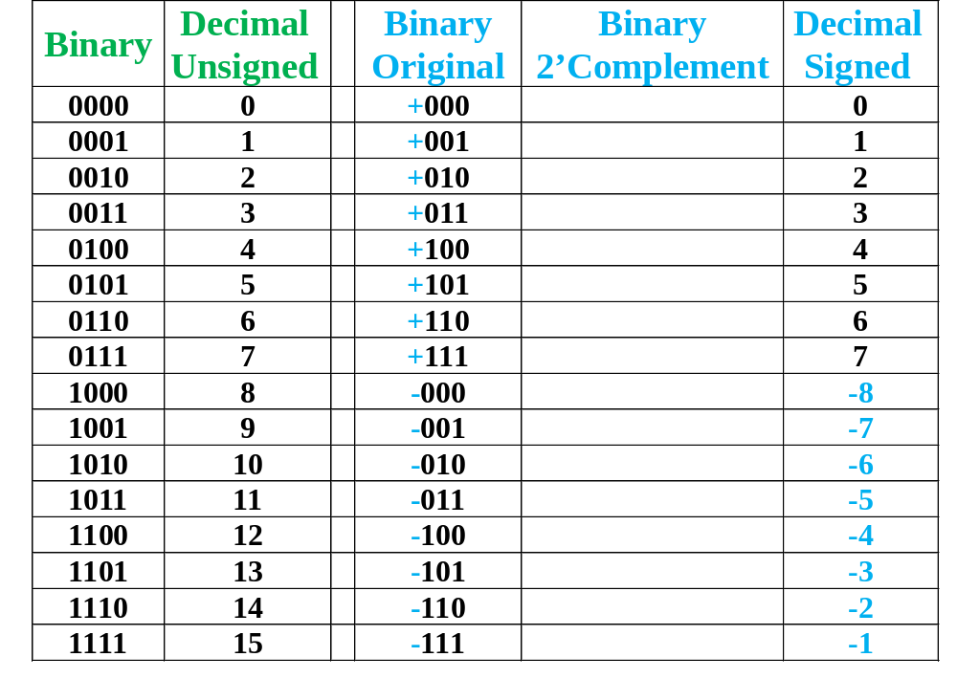
Positive
Sign-magnitude
Positive & Negative
0000
0001
0010
0011
0100
0101
0110
0111
—
1111
1110
1101
1100
1011
1010
1001

Slide 25
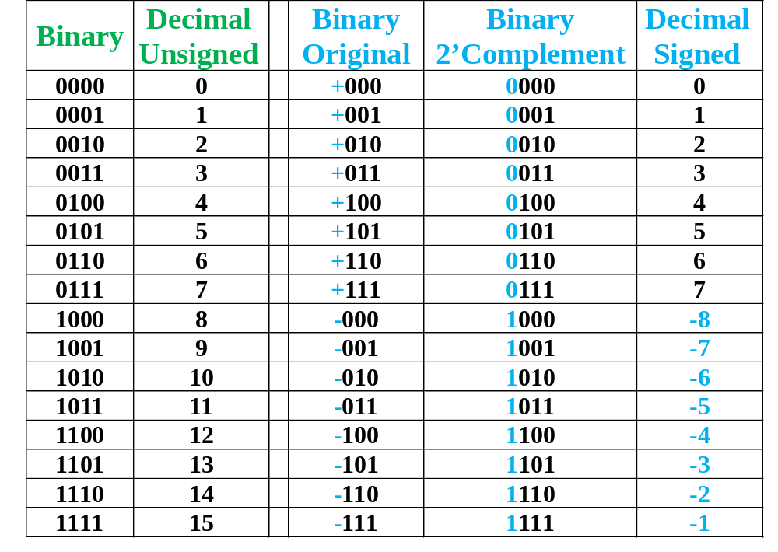
Positive
Sign-magnitude
Positive & Negative
Chap2.2
For Subtraction of 2’Complement Signed number:
A - B = A+ ( -B )_{2’s}
= A+ (~B+1)
For example:
5-2→
0101-0010=0101+(-0010) _{2’s}
=0101+ ( 1101+1)
=0011
0000
0001
0010
0011
0100
0101
0110
0111
—
1111
1110
1101
1100
1011
1010
1001
We can get the ‘-B’ from ‘B’:
1. Complement every bit.
2. Add a 1 to the result obtained from Step 1.

Slide 26
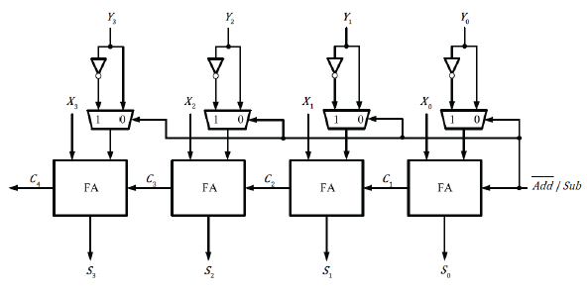
Structure of addition/subtraction
Using a 2-1 MUX to select operations
  Addition → X+Y+0=X+Y
  Subtraction → X+(~Y)+1=X+(-Y) _{2’s}=X-Y
Y3
Y2
Y1
Y0
X3
X2
X1
X0
0
1
C4
C3
C2
C1
Add/sub
S3
S2
S1
S0

Slide 27
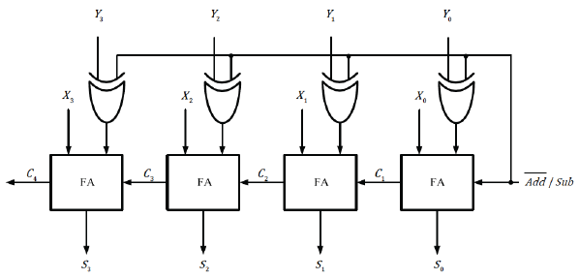
Structure of addition/subtraction
The same function can be achieved by replacing the multiplex and inverter with an XOR gate.
Y3
Y2
Y1
Y0
X3
X2
X1
X0
y0
Y0’
C4
C3
C2
C1
0
1
Add/sub
y⊕0=y
y⊕1=y’
S3
S2
S1
S0

Slide 28
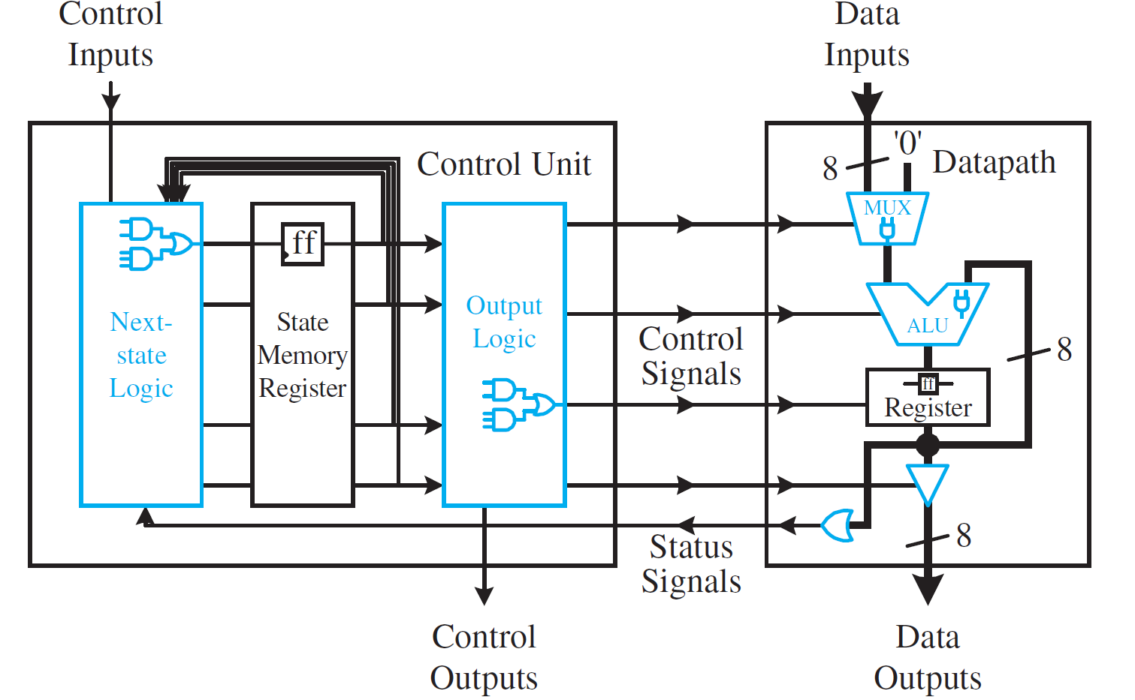
5. Arithmetic and Logic Units-ALU
Chap 4.6

Slide 29
5. Arithmetic and Logic Units-ALU
Chap 4.6
ALU: perform one of a number of different arithmetic and logic operations on a pair of n-bit operands.
Operations to be performed is specified by a set of function select inputs.
How to build a simplest ALU?
Logic equation
Truth table
k-map
Function Table
Sel
F
Structural thinking
0
1
A + B
arithmetic
1-bit Adder
Logic circuit
A or B
Logic
2-1
_{MUX}
F
2 input OR gate
S

Slide 30

Building a more complicated ALU by Structural thinking
  Add more functional parts
  Expanding the function selecting components
Function Table
1-bit Adder
Sel
F
2-1
_{MUX}
F
0
1
000
001
010
….
111
A + B
2 input OR gate
N-1
MUX
A or B
A – B
…..
_{Left Shift A}
….
S2S1S0
n-bit shifter
Chap 4.10

Slide 31
MSI ALU
4-bit ALU MSI 74x181
2⁴ operations
74x181
G
P
Carry generate
Select operation
S0~S3
Carry propagate
0-arithmetic / 1-logic
M
A=B
CIN
F0~F3
Function outputs
A0~A3
4-bit operands
B0~B3
COUT
Carry out

Slide 32
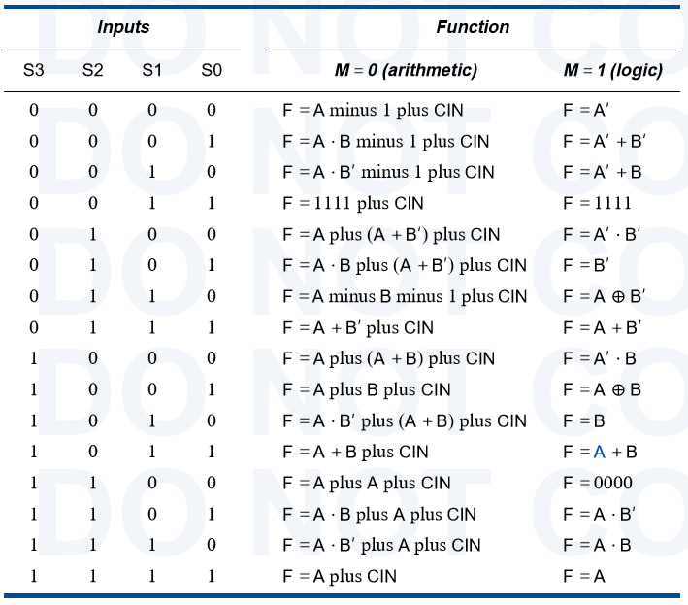
Function table for 74x181

Slide 33
Required reading
  Digital System Design with VHDL
Charles H.Roth,Jr. ,Lizy Kurian John著，梁松海改编
      Chapter 1, Review of Logic Design Fundamental
  Digital Design: Principles and Practices
  4th Edition, John F. Wakerly, 6.4,6.5,6.7-6.9

